Slide 1

Working with Image Generation

Slide 2
What We Will Cover
Understanding Image Endpoints
Generating New Images
Examining the Prompt
Saving Your Images
Editing Images (aka “Inpainting”)
Creating Image Variants

Slide 3
Understanding Image Endpoints
Generating, Editing, and Creating Alternates

Slide 4
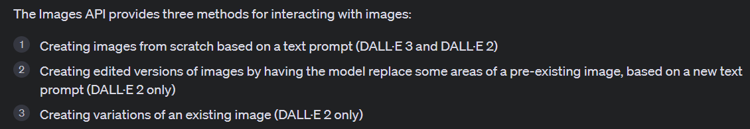
Notes:
https://platform.openai.com/docs/guides/images/introduction

Slide 5
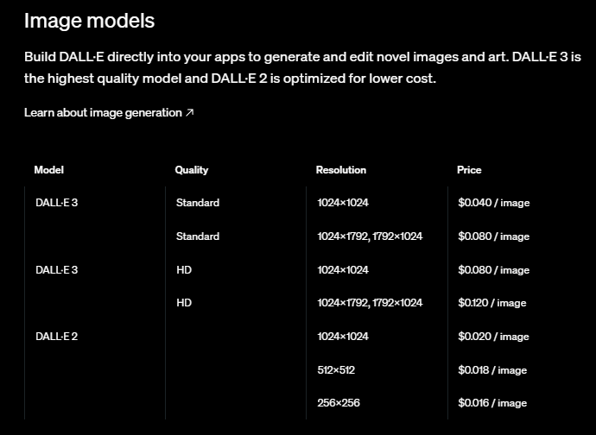
Notes:
https://openai.com/api/pricing/

Slide 6
Generating New Images
Input a Prompt and Get an Image

Slide 7
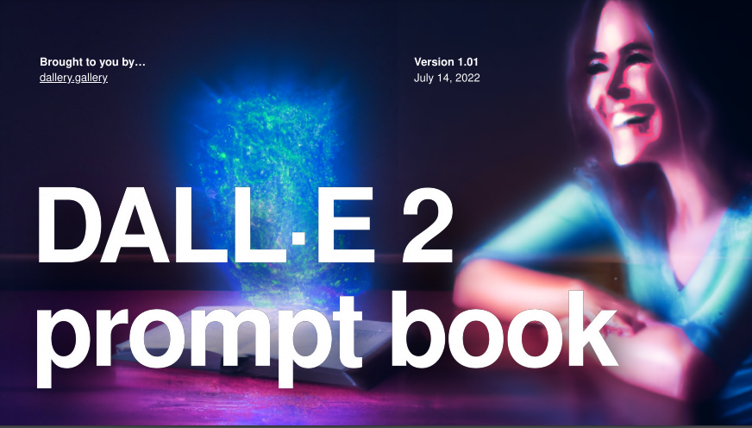
Notes:
https://dallery.gallery/wp-content/uploads/2022/07/The-DALL%C2%B7E-2-prompt-book-v1.02.pdf

Slide 8
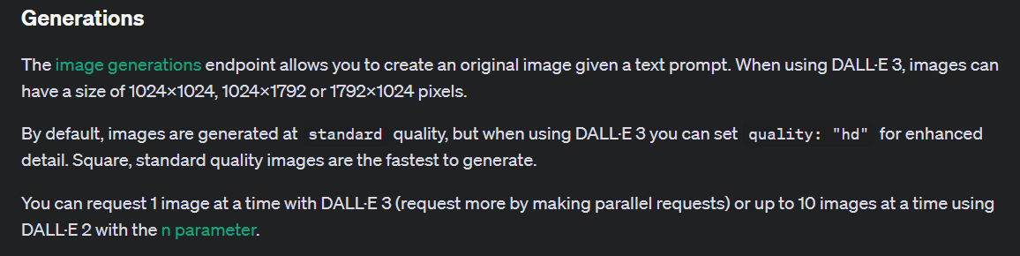
Notes:
https://platform.openai.com/docs/guides/images/generations

Slide 9
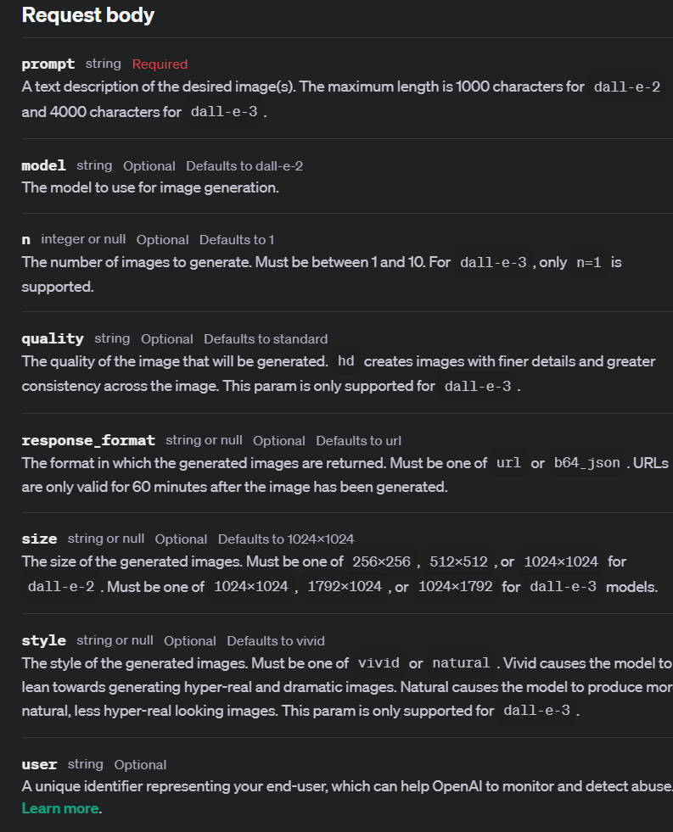
Notes:
https://platform.openai.com/docs/api-reference/images/create

Slide 10
Demo: Generating a Simple Image
# Simple image generation
image = client.images.generate(
prompt="a cabin on a snowy hillside at night",
)
image_url = image.data[0].url
# Display the image
display(Image(url=image_url))

Slide 11
Demo: Generating an Image with Full Parameters
# Full parameter generation
image_full_parameters = client.images.generate(
prompt="a cabin on a snowy hillside at night",
model="dall-e-3",
n=1,
quality="standard",
response_format="url",
size="1024x1024",
style="natural",
user="user-id-123"
)
image_url = image_full_parameters.data[0].url
# Display the image
display(Image(url=image_url))

Slide 12



Notes:
https://www.youtube.com/channel/UC35ZpwldGw7ZJ5R-2sLijzw

Slide 13

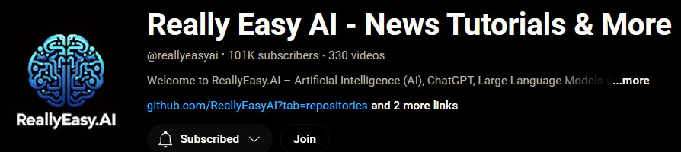
Membership has its privileges
Notes:
https://www.youtube.com/channel/UC35ZpwldGw7ZJ5R-2sLijzw/join

Slide 14
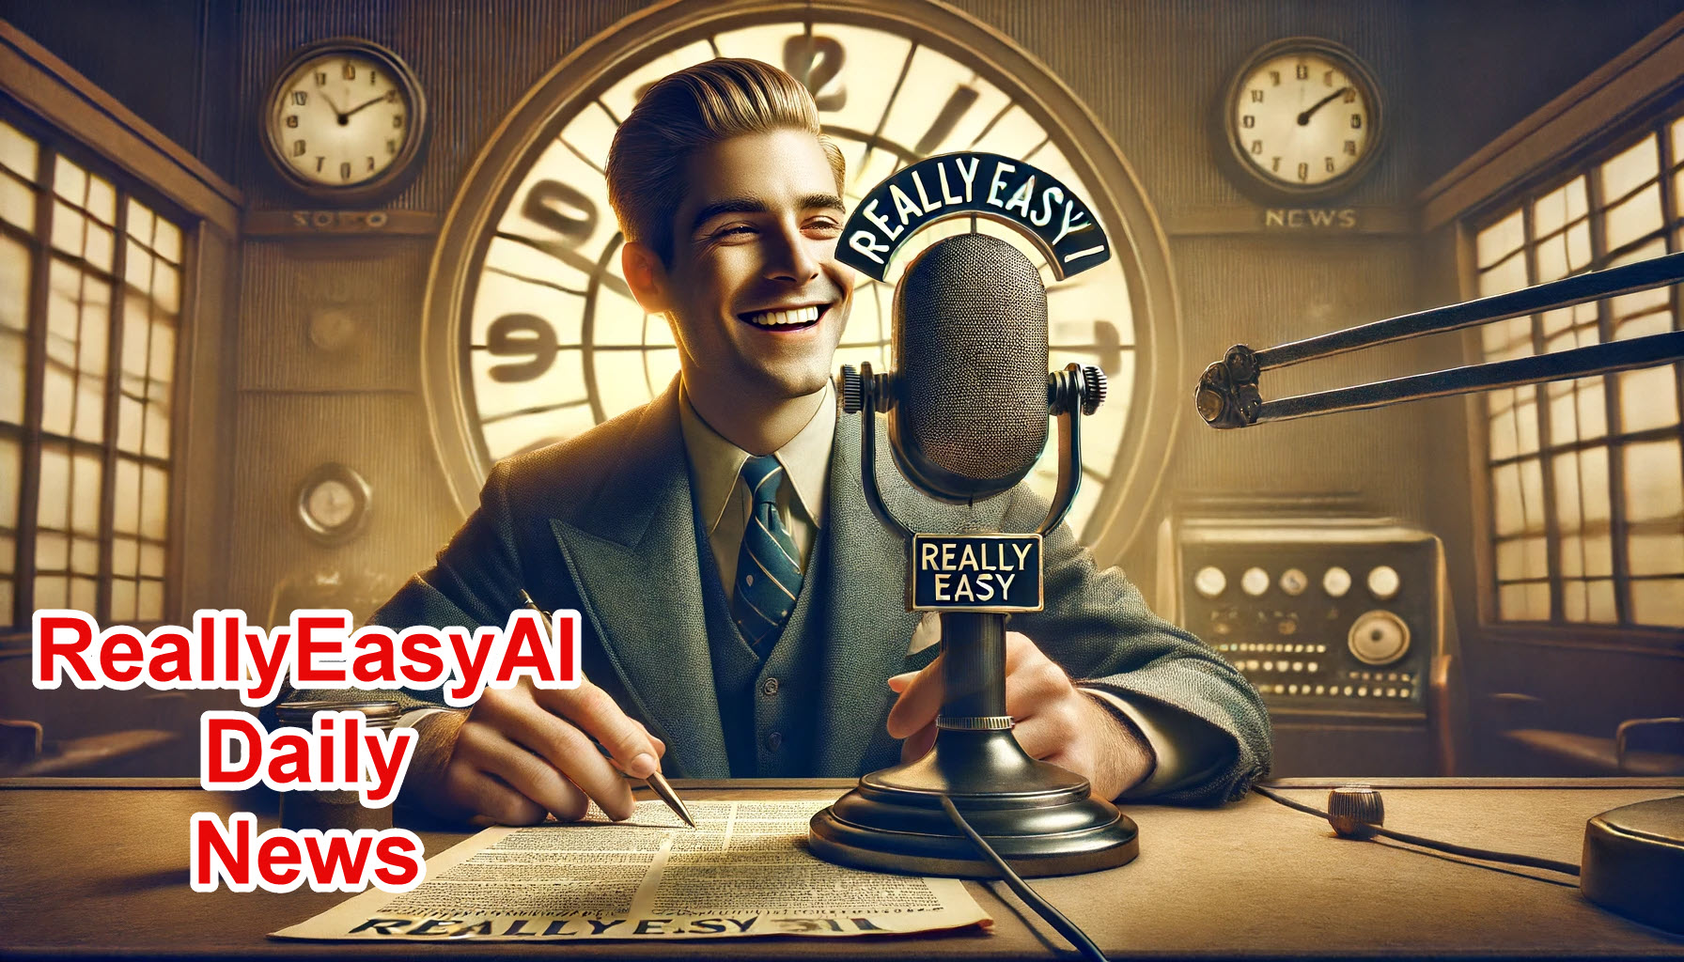
https://www.youtube.com/@AINewsFresh

Slide 15
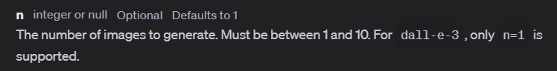
Notes:
https://platform.openai.com/docs/api-reference/images/create#images-create-n

Slide 16
Demo: Creating Multiple Images
# Generate multiple images
images = client.images.generate(
prompt="a cabin on a snowy hillside at night",
model="dall-e-2",
n=10,
quality="standard",
response_format="url",
size="256x256",
style="natural",
user="user-id-123"
)

Slide 17
Examining the Prompt
Prompt Rewriting by the LLM

Slide 18
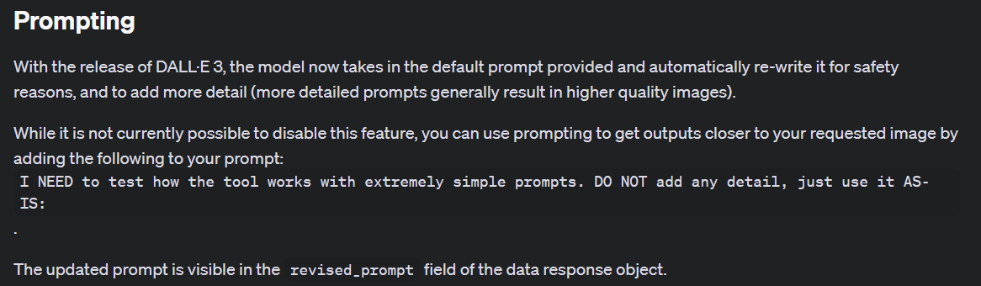
Notes:
https://platform.openai.com/docs/guides/images/prompting

Slide 19
Demo: Examining the Revised Prompt
image_url = image_full_parameters.data[0].url
# Show the before and after prompts
print("Original Prompt:")
print(prompt)
print("\n")
print("Revised Prompt:")
print(image_full_parameters.data[0].revised_prompt)

Slide 20
Demo: Attempting to Override the Revised Prompt
prompt = "I NEED to test how the tool works with extremely simple prompts. DO NOT add any detail, just use it AS-IS: a cabin on a snowy hillside at night"

Slide 21
Saving Your Images
Keep Your Great Pics!

Slide 22

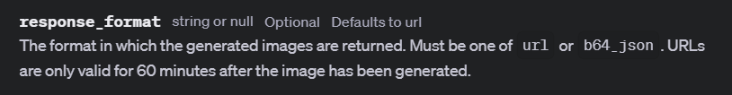
Notes:
https://platform.openai.com/docs/guides/images/example-dall-e-3-generations
https://platform.openai.com/docs/api-reference/images/create#images-create-response_format

Slide 23
Demo: Saving Your Pictures
# Download the image
image_data = requests.get(image_url).content
# Save the image to a file
with open('snowy_cabin.png', 'wb') as handler:
handler.write(image_data)
print("Image downloaded and saved as 'generated_image.png'")
# Get the Base64 image data
b64_image = image_full_parameters.data[0].b64_json
# Decode the Base64 image
image_data = base64.b64decode(b64_image)
# Display the image
display(Image(data=image_data))
# Optionally save the image to a file
with open('b64_snowy_cabin.png', 'wb') as handler:
handler.write(image_data)

Slide 24
Editing Images (DALL-E 2 Only)
AKA “Inpainting”

Slide 25
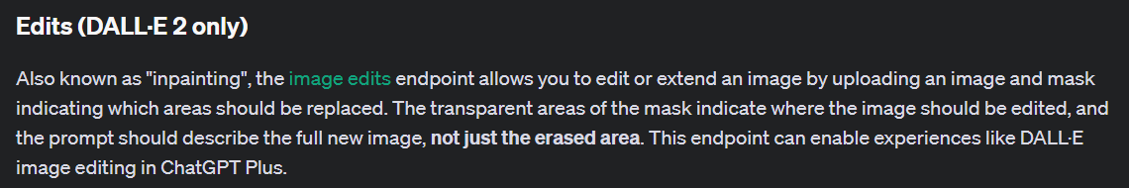
Notes:
https://platform.openai.com/docs/guides/images/edits-dall-e-2-only

Slide 26
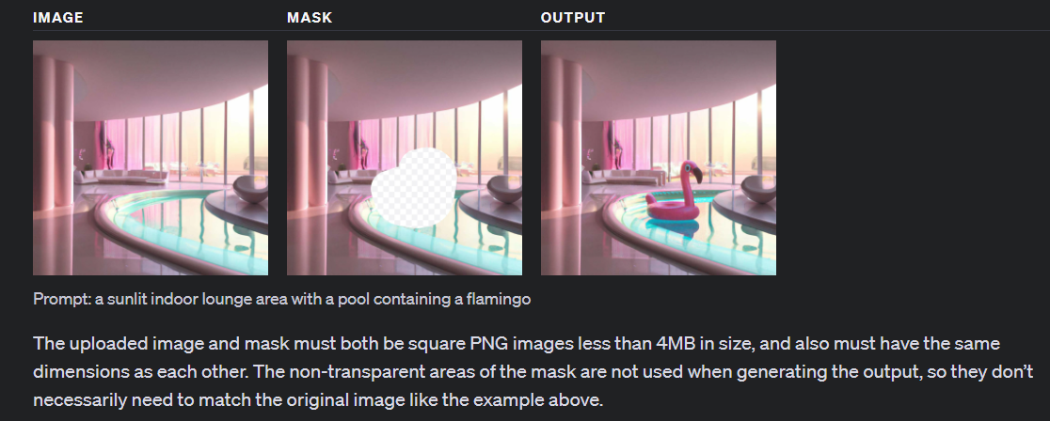

Slide 27
Demo: Edit an Image
response = client.images.edit(
image=open("pool_rgba.png", "rb"),
mask=open("pool_rgba_mask.png", "rb"),
prompt="add a flamingo toy to the water",
n=1,
size="1024x1024"
)

Slide 28
Image Variants (DALL-E 2 Only)
Getting Different Versions

Slide 29
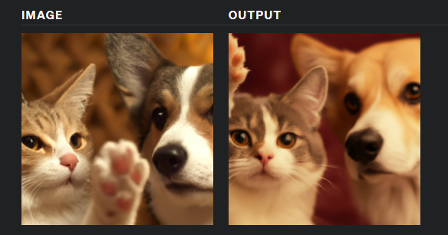

Slide 30
Demo: Create a Variant
response = client.images.create_variation(
model="dall-e-2",
image=open("pool_rgba.png", "rb"),
n=1,
size="1024x1024"
)

Slide 31
Generating Images with Chat Completion
Let’s make it more “ChatGPT”-Like

Slide 32
Demo: Generating Images with Chat Completion
tools = [
{
"type": "function",
"function": {
"name": "create_image",
"description": "Generate an image based on the given prompt.",
"parameters": {
"type": "object",
"properties": {
"prompt": {
"type": "string",
"description": "The prompt used to generate an image."
},
},
"required": ["prompt"],
},
}
}
]

Slide 33
Generating Images with Assistants
Supercharge Your Assistants!

Slide 34
Demo: Generating Images with Assistants
def handle_requires_action(self, data, run_id):
tool_outputs = []
for tool in data.required_action.submit_tool_outputs.tool_calls:
if tool.function.name == "create_image":
# Parse the arguments for the function call
arguments = json.loads(tool.function.arguments)
prompt = arguments.get('prompt')
# Call the get_temperature function and prepare the output
image_url = create_image(prompt)
tool_outputs.append({"tool_call_id": tool.id, "output": str(image_url)})
# Submit all tool_outputs at the same time
self.submit_tool_outputs(tool_outputs, run_id)

Slide 35
